Slide 1


Telemedicine @
National Resource Center & Mobile Telemedicine Van
School of Telemedicine & Biomedical Informatics
Sanjay Gandhi Post Graduate Institute of Medical Sciences
Lucknow, India-226014

Slide 2
Agenda
Background
Historical Development
Infrastructure
Activities
Way Ahead

Slide 3
Background

Slide 4

Telemedicine Projects
1999 Onwards
School of Telemedicine & Biomedical Informatics
(2006)
Services
  Clinical Services
  Audiovisual
  Digital Media
  Conference Services
National Resource Center for Telemedicine & Biomedical Informatics
DeitY, MCIT, GoI (2007-2011)
National Resource Center for National Medical College Network
MoH&FW, GoI (2011 onwards)
International and National Consultancy

Slide 5
SGPGI Telemedicine Programme
Management Committee
Prof. Rakesh Kapoor | Director, Chairman
Prof. S. K. Mishra | Dean
Prof. Girish Gupta | Faculty In-charge, Research
Prof. Rakesh Agarwal | Member
Prof. P. K. Pradhan | Member
Prof. S. K. Mishra | Member Secretary & Nodal Officer

Slide 6
Historical Development

Slide 7
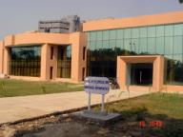
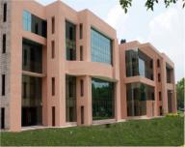
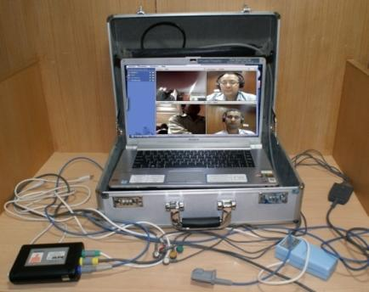
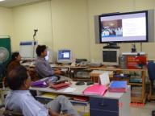
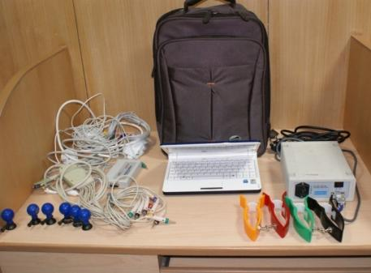
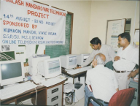
Historical Development of
SGPGI Telemedicine Programme
1999
2001
2006
2008
2009
2010
First two floor of School of Telemedicine & Biomedical Informatics
ICMR Project Phase I for Biomedical Informatics
Four Story Building of School of Telemedicine & Biomedical Informatics
(National Resource Centre)
DeitY, MCIT, GoI (2007-2011)
SAARC Telemedicine Network
mHealth4U Portable Tool
UP Medical College Network
Allahabad
Meerut
Kanpur
Office of HoD, Dept. of Endocrine Surgery
Telemedicine Facility in Operation Theatre Complex
First Research Grant

Slide 8
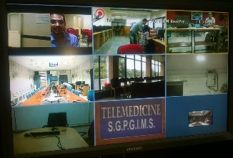
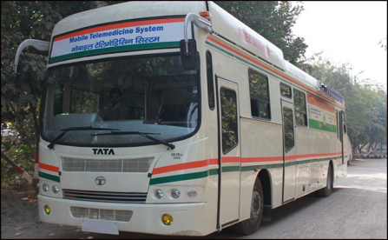
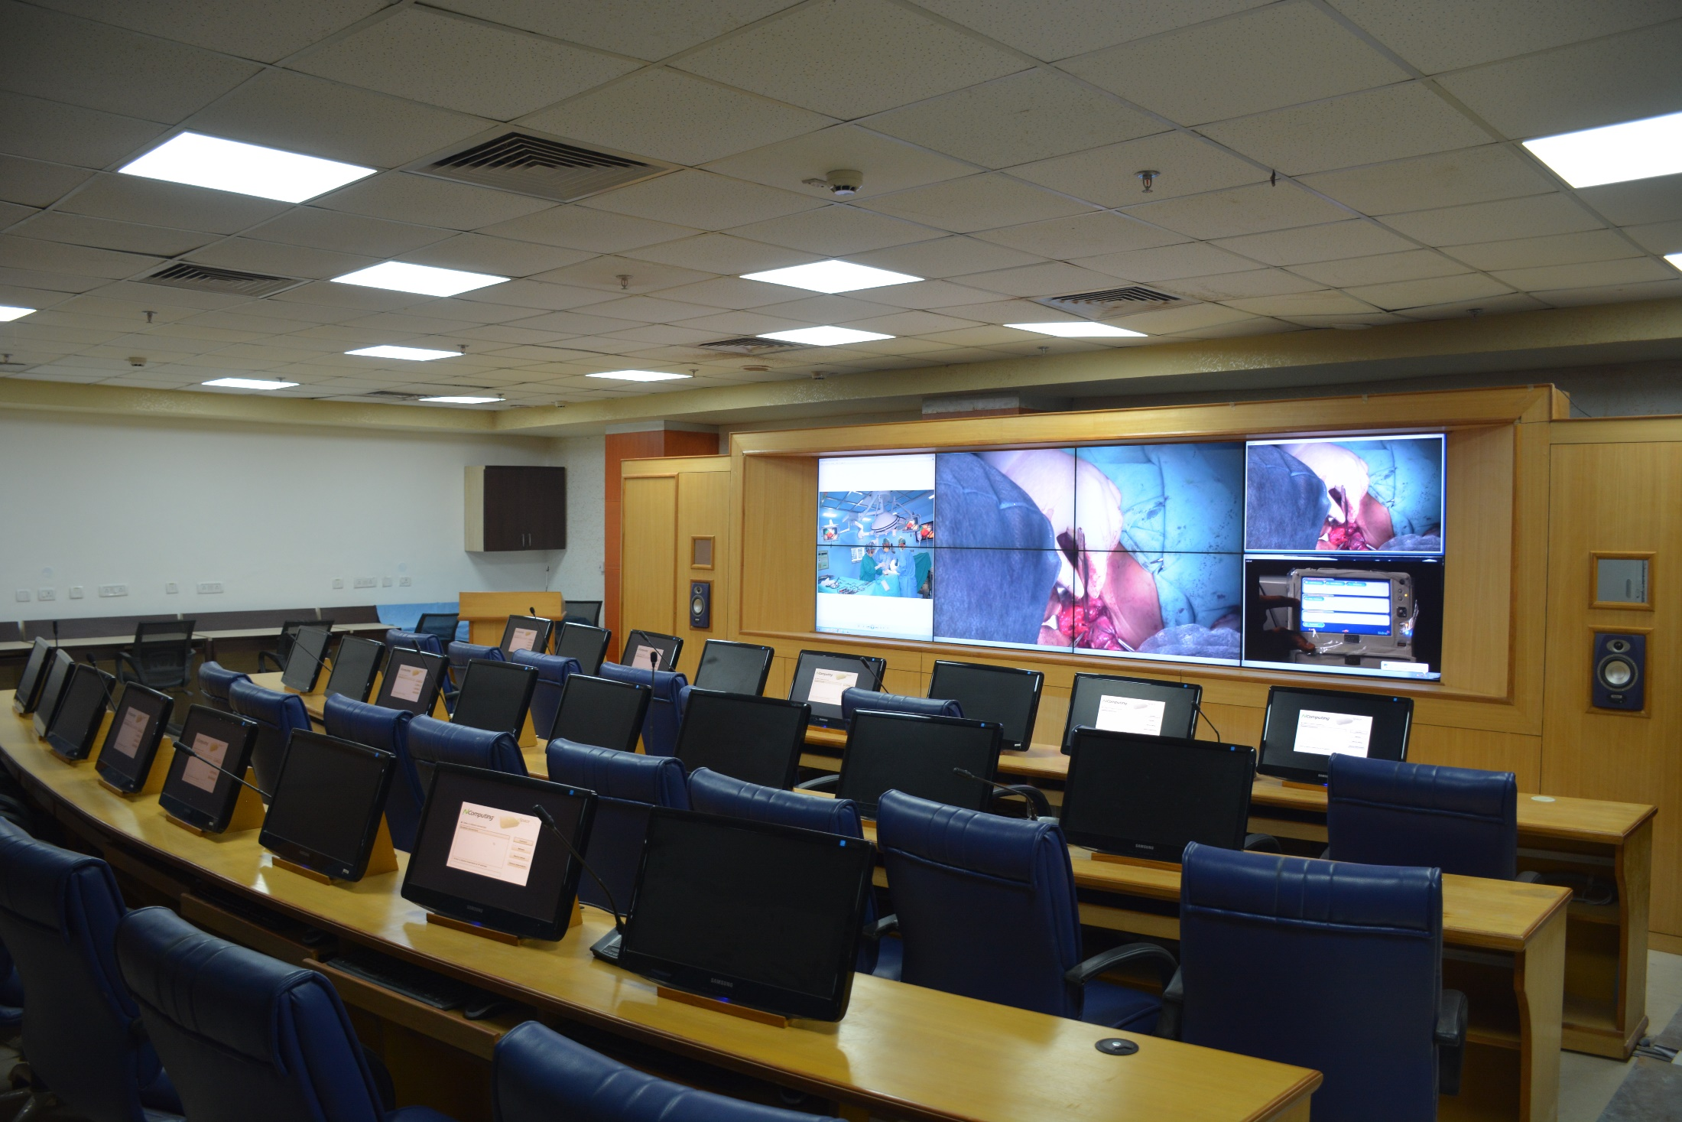
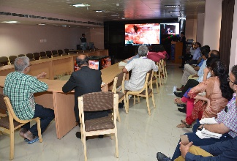
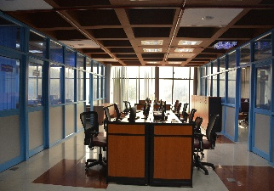
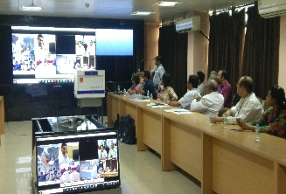
Historical Development of
SGPGI Telemedicine Programme
2011
2012
2013
2015
2016
2017
PAN Africa eNetwork
National Medical College Network (NMCN)
Mobile Telemedicine System (MTS)
Telemedicine on Wheel
Tele-presence Suite
eTumour Board
NMCN OFFICE
eStudio
CollabDDS

Slide 9
Evolution of telecom infrastructure at SGPGI
Communication | Bandwidth | Year | Network / Source
ISDN Lines | 384 Kbps | 1999 | Institute Resource
ISRO VSAT | 256 Kbps | 2003 | Orissa Telemedicine
Reliance | 1 Mbps | 2006 | Raibareli District Hospital under GAIL CSR
BSNL | 512 Kbps | 2008 | SAARC Telemedicine
Railtel | 1 Gbps | 2010 | National Knowledge Network
BSNL- Fiber to Home (FTTH) | 100 Mbps | 2010 | Institute Resource
AirTel | 2 Mbps | 2011 | Pan-African eNetwork

Slide 10
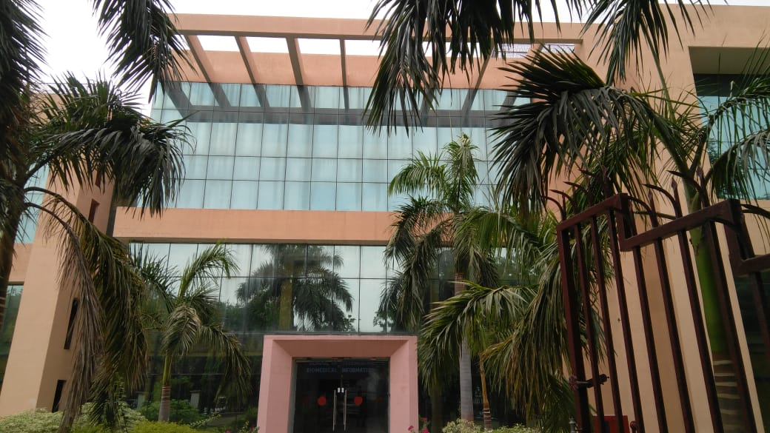
Total Expenditure INR 30,00,00,000 (30 Crore) sanctioned by
Govt. of Uttar Pradesh for establishment of School of Telemedicine & Biomedical Informatics
June 2003- August 2006

Slide 11
National Resource Center for
Telemedicine & Biomedical Informatics
DeitY, MCIT, GoI (2007-2011)
Funded (R&D Grant) by Department of Electronics and Information Technology (DeitY), Ministry of Communications & IT (MCIT), Govt. of India (GoI)
27th February 2007 – Admin. Approval Received
12th June 2007 - Project Manpower Recruitment
9th Jan 2008 - 1st PRSG Meeting
Project Duration : 2007 – 2011
Grant Amount: 5.25 Crore
11 January 2011: 5th PRSG Meeting

Slide 12
Objectives
Objective | Status
Creation of various resource facilities in the field of Telemedicine & Medical Informatics under one roof | √
Offer structured training program in all the above disciplines to meet the future requirement of skilled manpower in various areas of medical informatics for the country and abroad | √
Research & Development in all the above fields towards application and product development | √
Providing consultancy to Government and private health care organizations in incorporation of telemedicine & medical informatics in health system towards improving quality of healthcare | √
Assisting nodal government departments on various policy matters in the field of Medical IT and carrying out standardization tests for products | √

Slide 13
National Resource Center for NMCN Project
MOH&FW, Govt. of India
2011 onwards
  To initiate, develop, strengthen, maintain and upgrade the existing telemedicine infrastructure at the Center
  To function as center content development facility
  To develop storage infrastructure, harbour the storage servers for running the National Medical College Telemediicne Network in the country as per the guidelines and instructutions issued by the MoHFW, GOI from time to time.
  To function as Data Centre for storing medical knowledge content, video network hub, scheduling telemedicine sessions:(National Health Knowledge Park)
  To hold responisbility for designing, developing, hosting and maintaining a National Portal on Health Knowledge Science Knowledge Management.
  To employ and provide qualified and experiences personnel to carry out the services.
  To submit a report/ documents in the manner specified by MoH&FW, GOI regarding the status / progress of activities under the scheme.
  The Institute has to undertake and ensure the sustenance of infrastructure thus created after the scheme ends.

Slide 14
Activities
Research & Development
Education & Training
Consultancy
Organisational Activities
eGoverance
Publications

Slide 15
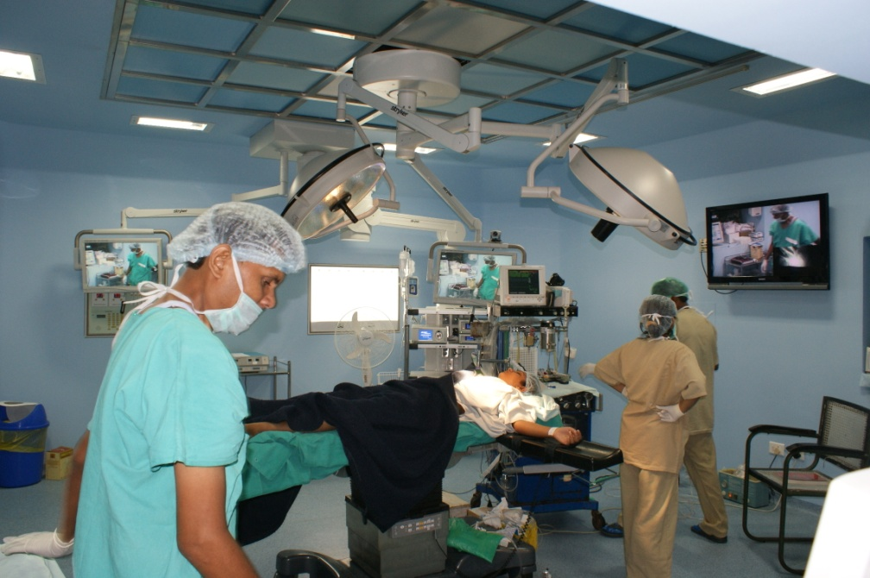
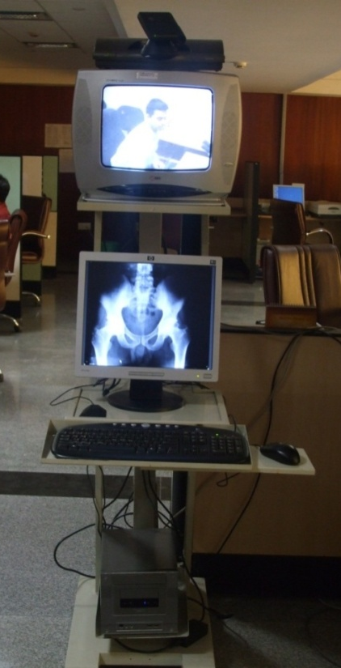
Research & Development
Digital Operation Theatre ( U.P. Govt. Support)
Low cost portable Telemedicine Unit
(Prototype Completed)

Slide 16
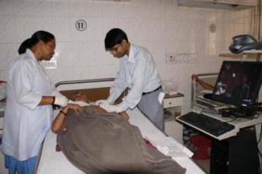
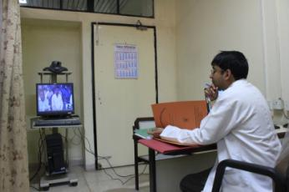
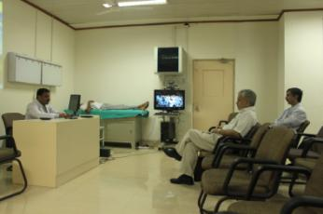
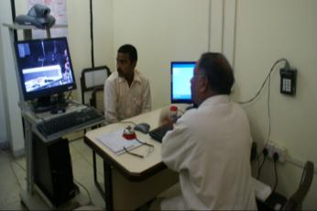
Mobile Telemedicine Kiosk
(Operational using Hospital LAN)
Mobile kiosk @ Patient’s bedside
Doctor’s Duty Room
Department’s Seminar Room
Tele-Clinic in Out Patient Department

Slide 17
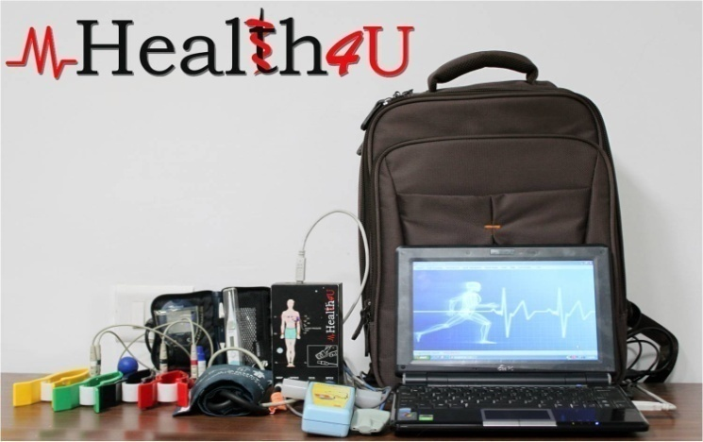


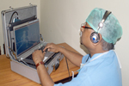
Mobile Portable System

Slide 18
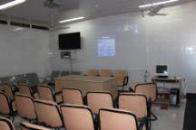
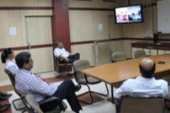
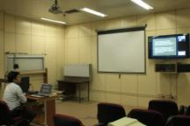
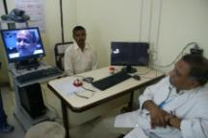
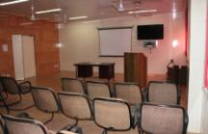

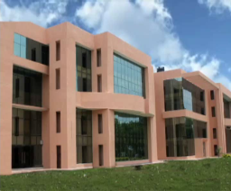
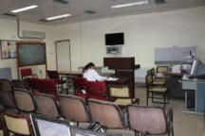
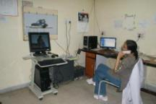
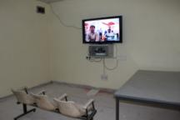
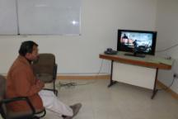
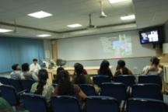
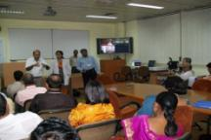
SGPGIMS Knowledge Network Enterprise
Nephrology
Endocrine Surgery
Radiology
Tele-Clinic
Neurology
SGPGIMS
Telemedicine
HUB at
School of Telemedicine &
Biomedical Informatics
(STBMI)
Mobile Kiosk @ WARD
Nuclear Medicine
Mobile Kiosk @ Doctor’s Duty Room
OT Cafeteria
Immunology
Pathology
Radiotherapy

Slide 19
Tele-mentoring Trial With AIMS, Kochi (March 2004)

Slide 20
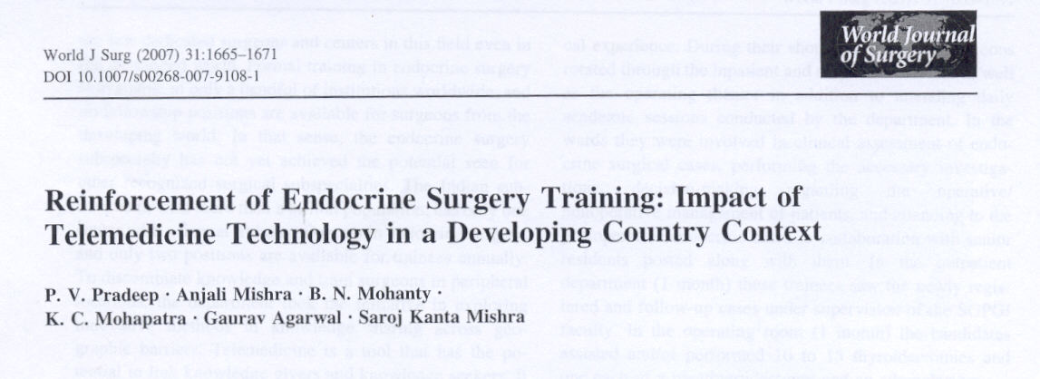
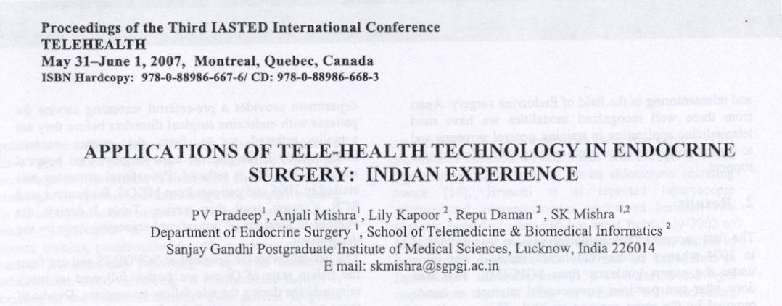
Live Surgery Transmission using Satcom
(Interactive Realtime)
Live Surgery Transmission to venue from SGPGI OT during
INTELMED- 2005, Bangalore using dedicated 2 Mbps satellite bandwidth

Slide 21
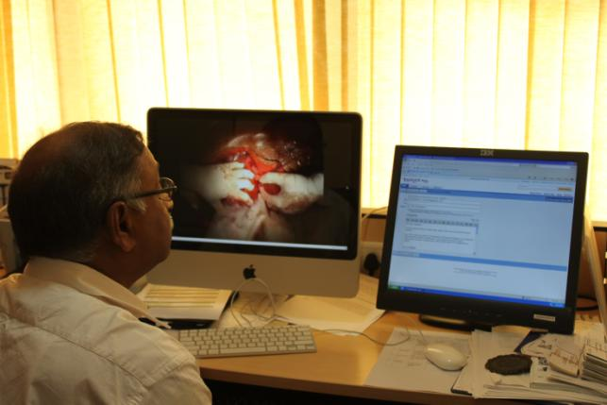
Live streaming of surgical video
Live streaming of surgical video at doctor’s workplace

Slide 22
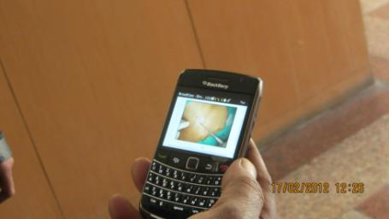
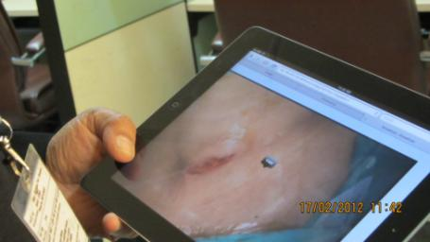
Mobile Learning

Slide 23
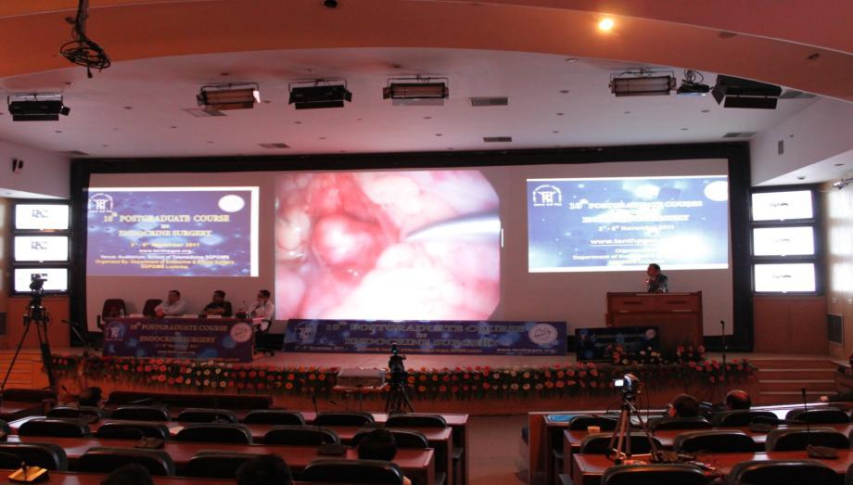
Integrated Networked Lecture Theatre/ Auditorium

Slide 24
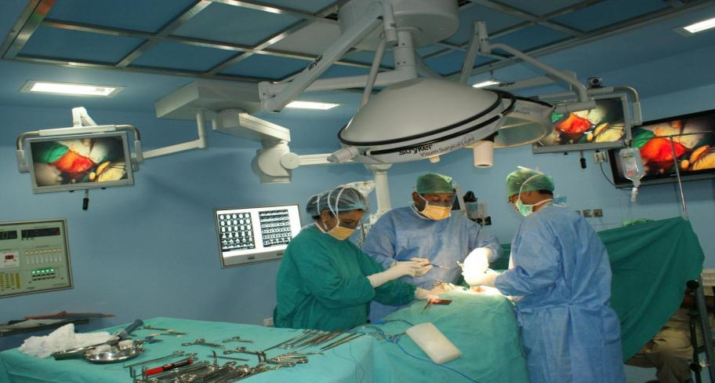
Digital, Integrated Operation Theatre

Slide 25
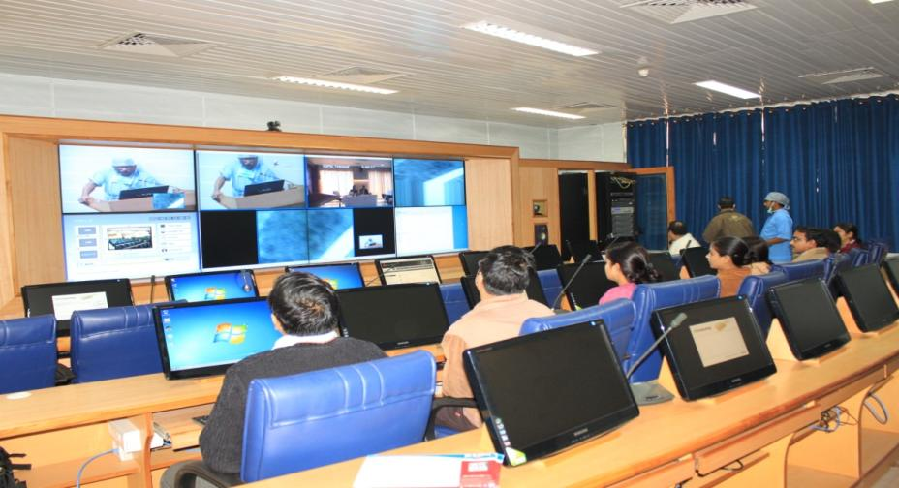
Surgical Telepresence Suite

Slide 26

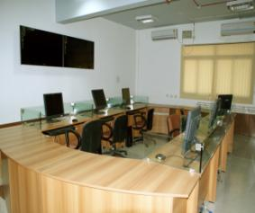
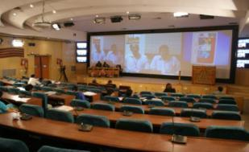
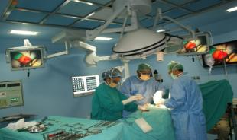
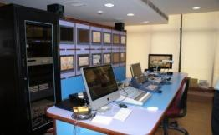
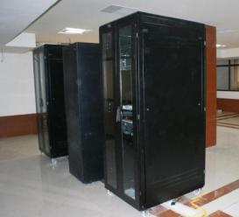
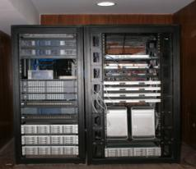
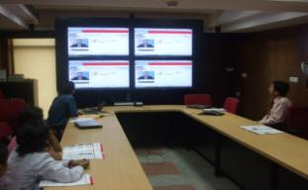
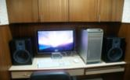
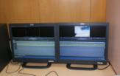
Knowledge Processing Edit/Voice Over
SGPGI Knowledge Engineering Architecture
Hi-Tech Lecture Theatre
Broadcast Quality Studio Camera
Network Monitoring Hub
Integrated Operation Theatre
Production Control Unit (PCR)
Video Conferencing Suite
Edit Stations
Data Server

Slide 27


Data Center (National Resource Center)
Web Servers, Mail Servers
Data & Video Storage
Video Bridge RMX 2000
Video Scheduler
Streaming Server RSS 2000
Wide Area Application Server (WAAS)
Hospital Backup Servers
Proxy Servers
Application Servers
UP Medical College Network
National Medical College Network
National Knowledge Network
SAARC Telemedicine & PAN Africa e-Network
SGPGI Knowledge Network

Slide 28

Institution based Knowledge Repository
SGPGI Knowledge Park

Slide 29
Activities
Research & Development
Education & Training
Consultancy
Organisational Activities
eGoverance
Statistics & Publications

Slide 30






Education & Training

Slide 31









Tele-education & Telehealth Services

Slide 32


Special Interest Group(SIG)
APAN43 - Endocrine Surgery

Slide 33

Asia Pacific Advance Network (APAN)
APAN44 - Endoscopic Club E-conference (ECE)

Slide 34


Tele-Rheumatology
SCB Medical College Cuttack

Slide 35


Nuclear Medicine Followup Tele-Clinic

Slide 36


Endocrine Surgery ( EESENCE)
Endocrine Surgery Alumni collaborative learning (SESAN) through web VC collaboration
Airport

Slide 37


eTumour Board
06-09 Sept 2017
Live Robotic Surgery during PGES2017

Slide 38

Mobile Telemedicine System
49 Camps so far
Year | No. of Camps | Patients Benefited
2013 | 25 | 831
2014 | 24 | 2267

Slide 39




Community Outreach Programme & Public Health Services

Slide 40




Consultation

Slide 41









Content Creation for Patient Awareness

Slide 42







Web Designing

Slide 43
Activities
Research & Development
Education & Training
Consultancy
Organisational Activities
eGoverance
Statistics & Publications

Slide 44



International Consultancy
As ITU e-health expert in Nepal (2006)
As WHO e-health expert in Maldives (2007)& North Korea (2007,2008)

Slide 45






WHO – North Korea Telemedicine Network
World Bank - Maldive’s eHealth Network

Slide 46



Asia Pacific Advance Network
(APAN)
Trans-Eurasia Information Network (TEIN)
Deutsches Herzzentrum Berlin
(DHZB)

Slide 47



ASEAN India eNetwork
BRICS Expert Group Meeting
Central Asia eNetwork

Slide 48






National
State Governments
Govt. of India

Slide 49






SAARC Telemedicine Network

Slide 50

SAARC Telemedicine Network

Slide 51
SAARC Telemedicine Network
(2008 onward)
Name of Hospital | Date of Activation | Total Sessions | 2009 | 2010 | 2011 | 2012 | 2013 | 2014
JDWNRH, Thimpu, Bhutan | 21 Oct 2008 | 66 | 22 | 25 | 19 | - | - | -
Indira Gandhi Children’s Hospital, Kabul, Afghanistan | 17 August 2009 | 184 | 8 | 23 | 44 | 36 | 35 | 38
Patan Hospital, Nepal | 19 July 2010 | 71 | - | 5 | 5 | 32 | 15 | 14

Slide 52



PAN Africa Network

Slide 53

PAN Africa e-Network

Slide 54
Pan Africa eNetwork (2011)
Started on Feb 2011
Connected with 47 African Countries
> 258 Session delivered and archived in the datacenter of STBMI
(06+ 02) Session Per Month.
106 Faculty Members of 28 Departments participated in Pan Africa eNetwork
INR 12,71,460 Received so far and Distributed
INR 10,16,100

Slide 55
Activities
Research & Development
Education & Training
Consultancy
Organisational Activities
eGoverance
Statistics & Publications

Slide 56




IITF Trade Fair 2014

Slide 57




North Eastern Regional Workshop for Sensitization and Awareness on NMCN at NEIGRIHMS, Shillong
26-27 Sept 2014

Slide 58




West Bengal orientation meet on NMCN project Awareness
23rd - 25th June 2014

Slide 59






National Workshop at NRC for creation of awareness on NMCN project

Slide 60




Regional Workshop at NRC-cum-RRC East for Sensitization & Awareness on NMCN project 2014

Slide 61
Activities
Research & Development
Education & Training
Consultancy
Organisational Activities
eGoverance
Statistics & Publications

Slide 62




eGovernance
UP CPMT Counselling

Slide 63
E-governance (UP CPMT Counseling)
Year | First Phase | Second Phase | Third Phase | Fourth Phase | Days | Hours of Video conferencing in Multi Point Conferencing
2011 | 12 -28 July (16) | 05- 13 Sept (08) | 17 to 18 Nov (02) |  | 26 Days | 260 Hrs
2012 | 16 -24 July (08) | 5 – 18 Sept (13) |  |  | 21 Days | 210 Hrs
2013 | 16 - 24 July (08) | 18 – 26 & 30 Sept (10) | 24 – 25 Oct (2) |  | 20 Days | 200 Hrs
2014 | 2-7 Aug (06) | 12-14 Aug (03) | 8-17 Sept (09) | 27-29 Oct (03) | 21 Days | 210 Hrs
 |  |  |  |  |  | 870 Hrs

Slide 64
Activities
Research & Development
Education & Training
Consultancy
Organisational Activities
eGoverance
Usage Statistics & Academic Output

Slide 65
Usage Statistics (1999 ~ 2014)
Activities | Number of Sessions
Tele-Education | 1862
Tele-Followup & Consultation | 333
CME Transmission | 156

Slide 66
Publications
Publications | Nos.
Book Chapter | 07
Peer Review Journal | 19
Proceeding Publications | 29
Invited Lectures (International) | 38
Invited Lectures (National) | 55
Scientific Paper (International Conferences) | 26
Scientific Paper (International) | 26
Scientific Paper (National) | 106

Slide 67
Way Ahead

Slide 68
Access to health care for all by Networking Medical Colleges with Public health institutions in phase wise manner– DH, CHC, PHCs, mhealth units
NMCN would ride over NKN : High speed optic fiber backbone
Utilization of NKN bandwidth at three different locations in Medical Colleges – Lecture Theatre, Hospital & Library
Integration of NKN with Campus WiFi/ LAN/ WAN and NOFN / NGN (3G/4G/Wi Max)/Satellite (National Telemedicine GRID)
First Phase of NMCN- Each Medical College to connect with two DH which in turn connect 10 PHC/CHCs/mhealth units depending on availability of network, technical manpower

Slide 69

National Medical College Network
Scalable , Hierarchal, Secured IPv6 compatible Network Riding over NKN
01 National Resource Center
07 Regional Resource Center
35 Medical Colleges

Slide 70

NRC & RRC
PGI Chandigarh
AIIMS New Delhi
STBMI, SGPGIMS, Lucknow
NEIGRIMHS, Shillong
IMS BHU
KEM HOSPITAL, Maharashtra
RRC
Trivendrum Medical College
NRC
JIPMER, Puducherry

Slide 71

PGI Chandigarh
Jammu & Kashmir
Punjab
Chandigarh
Haryana
Himachal Pradesh

Slide 72

AIIMS, New Delhi
UTs of Uttarakhand
Delhi
Madhya Pradesh
Chhattisgarh
Rajasthan

Slide 73

IMS BHU
Uttar Pradesh
Bihar
Jharkhand
West Bengal
Odisha
Andaman and Nicobar Islands

Slide 74

NEIGRIMHS, Shillong
Assam
Meghalaya
Tripura
Manipur
Sikkim
Arunachal Pradesh
Nagaland
Mizoram

Slide 75

JIPMER, Puducherry
Andhra Pradesh
Tamil Nadu
Karnataka
Kerala
Pudducherry

Slide 76

KEM Hospital, Mumbai
Maharashtra
Gujarat
Goa
Daman & Diu
Dadra & Nagar Haveli
Lakshadweep

Slide 77





UP Medical College Network
Block Diagram for Medical College Level : WAN & LAN Connectivity
Digital Lecture Theater
eLearning & Digital Library
Tele-Consultation Facility

Slide 78

National Telemedicine GRID
National Knowledge Network (NKN)
National Optic Fiber Network (NOFN)
State Wide Area Network
(SWAN)

Slide 79
Satellite & NGN Technology for Health
Mobile Telemedicine System for rural health service (RAAHAT – Rural Access to Advanced Healthcare Adopting Telemedicine)
Telemedicine Network Access for Tribal population, War zones, Hilly Region,Islands, Deserts, Ship, Boats/ Oil Rigs, etc.
National Disaster / Trauma, Accidents Emergency Telemedicine Network empowering Ambulances with GPS and Satcom
Tele-epidemiology using Remote sensing and Navigational Tools (eg. Applications in JE, H1N1, Chickengunia, Dengue etc.)
Remote health monitoring for Pilgrims of Kailash, Amarnath Yatra and Char Dhaam Yatra

Slide 80
SWOT Analysis
STRENGTH Mobile Conectivity & Internet Penetration Indigenous Low Cost Technology and System. Government Policy for Digital India and Strengthening Rural Service Infrastructure | WEAKNESS Lack of eHealth Policy and Advocacy Legal Framework yet to emerge ePrescription Authentication by regulatory body No Education & Training Infrastructure barring one at SGPGI, Lucknow Lack of Market Place for Indigenous Tools Lack of Public Perception and Awareness
OPPORTUNITY Decade old Telemedicine Experience around the country. NKN, NOFN & SWAN Indigenous Satellite System Wireless Broadband Internet through NGN Technology Manpower | THREAT Telemedicine as threat for caregivers. Health System adoption to compromise revenue Legal repercussion Security of Health Data

Slide 81
PPP Model for Rural Health
Odisha has adopted ICT as development tool
Odisha, the first state in the country has adopted ICT as a state development tool for providing healthcare services at the door step of the citizen.
OTTET in collaboration with Govt. of Odisha and National Resource Center for Telemedicine & Biomedical Informatics at SGPGIMS, Lucknow under PPP mode
http://egov.eletsonline.com/2013/03/odisha-has-adopted-ict-as-development-tool/

Slide 82


Green Telehealth Infrastructure
Chain of eHealth Centers in Rural and Semi Rural India
OMC & NRC Proposed Initiative

Slide 83


Green Ambulance

Slide 84
More resource centers besides current NRC and RRCs, in large states need to come up
Establishment of Institutions
Development of Human Resources for eHealth & Telemedicine
- Need of the Hour
Institutions for Education, Training, Research, Policy & Management etc on eHealth and Telemedicine eg.
Indian Institute of Telemedicine & eHealth in line with Indian Institute of Public Health

Slide 85
Thank You
www.sgpgi-telemedicine.org | www.nmcn.in | www.nrct.in | www.stbmi.ac.in | www.sgpgi.edu.in

